Slide 1
N-gram Language Models
CS 162: Natural Language Processing
Nanyun (Violet) Peng
Course website: https://vnpeng.net/cs162_win24.html
syllabus,
announcements,
slides,
homeworks
1

Slide 2
Important Announcements
Assignment 1 dues next Wednesday at 11:59pm.
Project planning report due next Monday at 11:59pm.
The submission link is up now!

Slide 3
What is a language model?
I ate
?
Example credit: Mark Dredze
Notes:
What is driving this technology
What do you need to know to answer this?

Slide 4
What is a language model?
For dinner I ate
?
Example credit: Mark Dredze
Notes:
What do you need to know to answer this?

Slide 5
What is a language model?
As a vegetarian for dinner I ate
?
Example credit: Mark Dredze
Notes:
What do you need to know to answer this?

Slide 6
What is a language model?
Despite being a vegetarian for dinner I ate
?
Example credit: Mark Dredze
Notes:
What do you need to know to answer this?

Slide 7
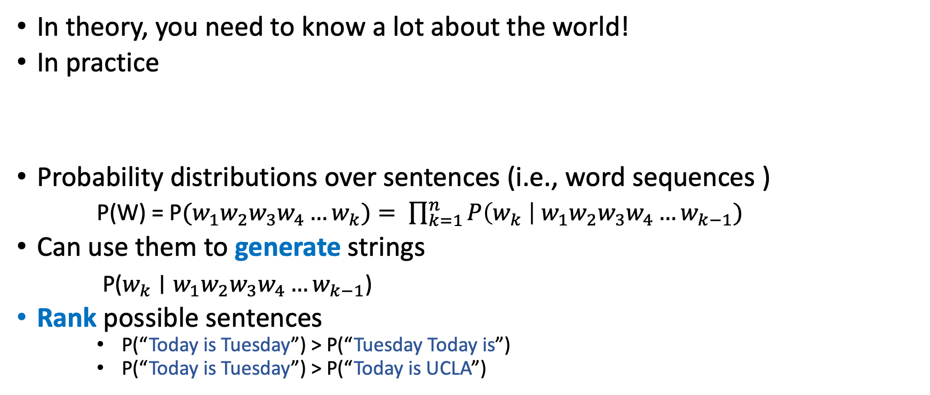
What is a language model?
In theory, you need to know a lot about the world!
In practice
Probability distributions over sentences (i.e., word sequences )
P(W) = P$(w_{1}w_{2}w_{3}w_{4}…w_{k})= \prod_{k=1}^{n}{P\left(w_{k} \right| {w_{1}w}_{2}w_{3}w_{4}…w_{k−1})}$
Can use them to generate strings
P($w_{k}∣{w_{1}w}_{2}w_{3}w_{4}…w_{k−1}$)
Rank possible sentences
P(“Today is Tuesday”) > P(“Tuesday Today is”)
P(“Today is Tuesday”) > P(“Today is UCLA”)
S = For dinner I ate pizza
Previous words (context)
Word being predicted

Slide 8
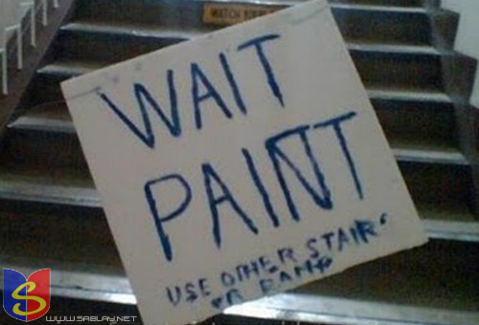
Language model applications
Context-sensitive spelling correction

Slide 9
Context-sensitive spelling correction
Which is most probable?
… I think they’re okay …
… I think there okay …
… I think their okay …
Which is most probable?
… by the way, are they’re likely to …
… by the way, are there likely to …
… by the way, are their likely to …

Slide 10
Machine Translation
 | good English? (n-gram) | good match to French?
Violet appeared in TV. |  | ✓
Appeared on Violet TV.
In Violet appeared TV. |  | ✓
Violet is happy today. | ✓
Violet appeared on TV. | ✓ | ✓
TV appeared on Violet. | ✓
TV in Violet appeared.
Violet was not happy. | ✓

Slide 11
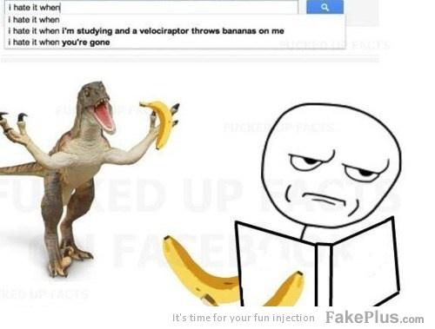
Autocompletion
Notes:
veloci'raptor

Slide 12
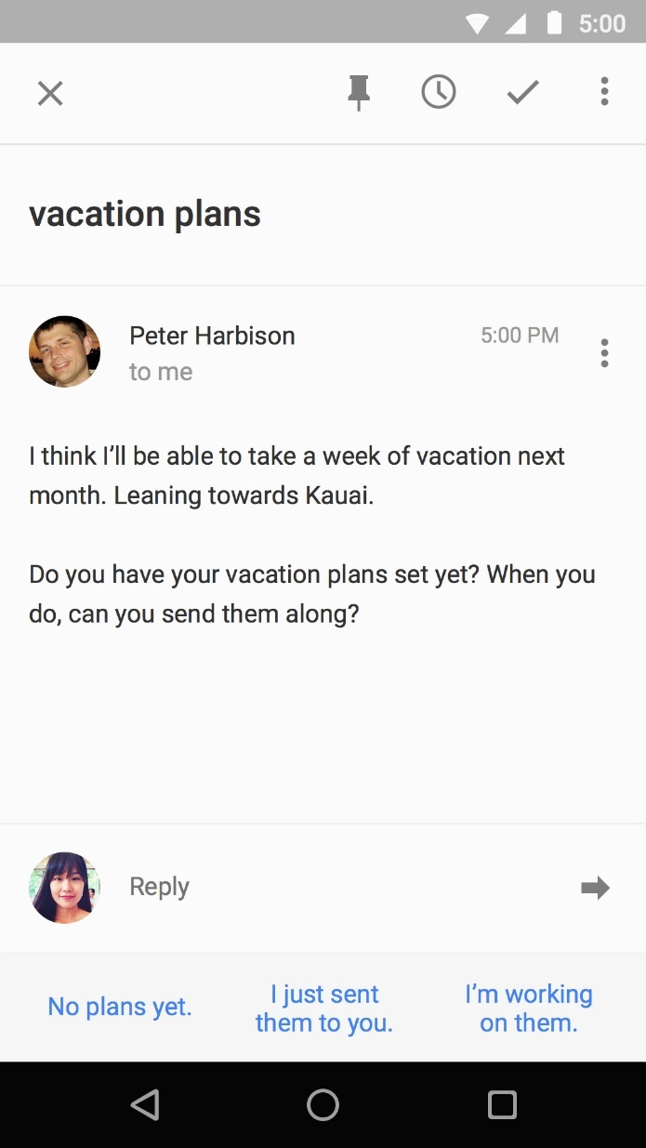
Smart Reply

Slide 13
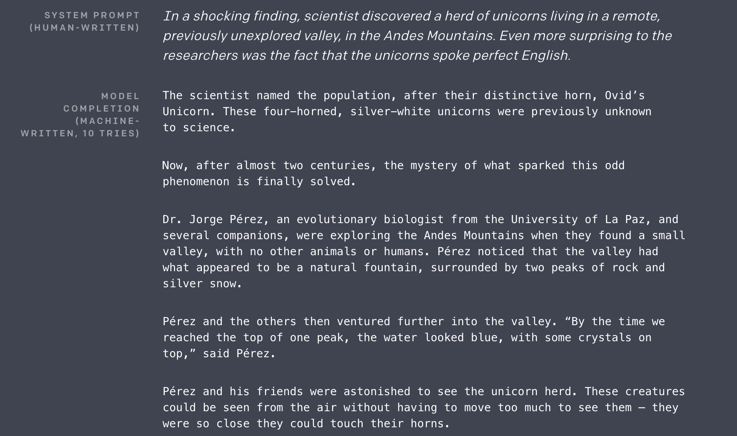
Language generation for everything
https://openai.com/research/better-language-models
GPT2 in 2019
ChatGPT in 2024
Notes:
When I found out my grandma was in the hospital I felt a particular color. When someone cut me off in the traffic I felt a different color. What is the most likely color I would see if I combined these two colors?
Michael is at that very famous museum in France looking at its most famous painting. However, the artist who made this painting just makes Michael think of his favorite cartoon character from his childhood. What was the country of origin of the thing that the cartoon character usually holds in his hand?
Can you write a sonnet about natural language processing class?

Slide 14
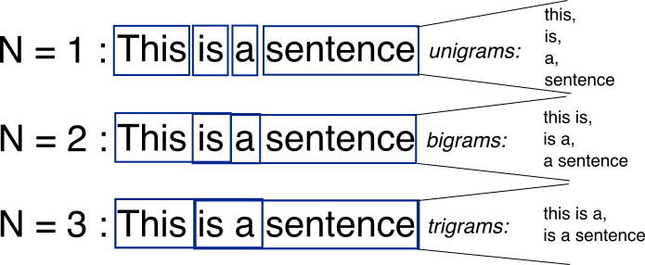
From Bag-of-Words to N-grams
N-grams: a contiguous sequence of n tokens from a given piece of text
N-gram LMs models p(x_{{t:t+n}}), or p(x_{t+n}|x_{{t:t+n-1}}).

Slide 15
Practical details (I)
Trigram model assumes two-word history
But consider these sentences:
What's wrong?
a sentence shouldn't end with 'yellow'
a sentence shouldn't begin with 'feeds'
Does the model capture these problems?
w₁ | w₂ | w₃ | w₄
he | saw | the | yellow.
feeds | the | cats | daily.

Slide 16
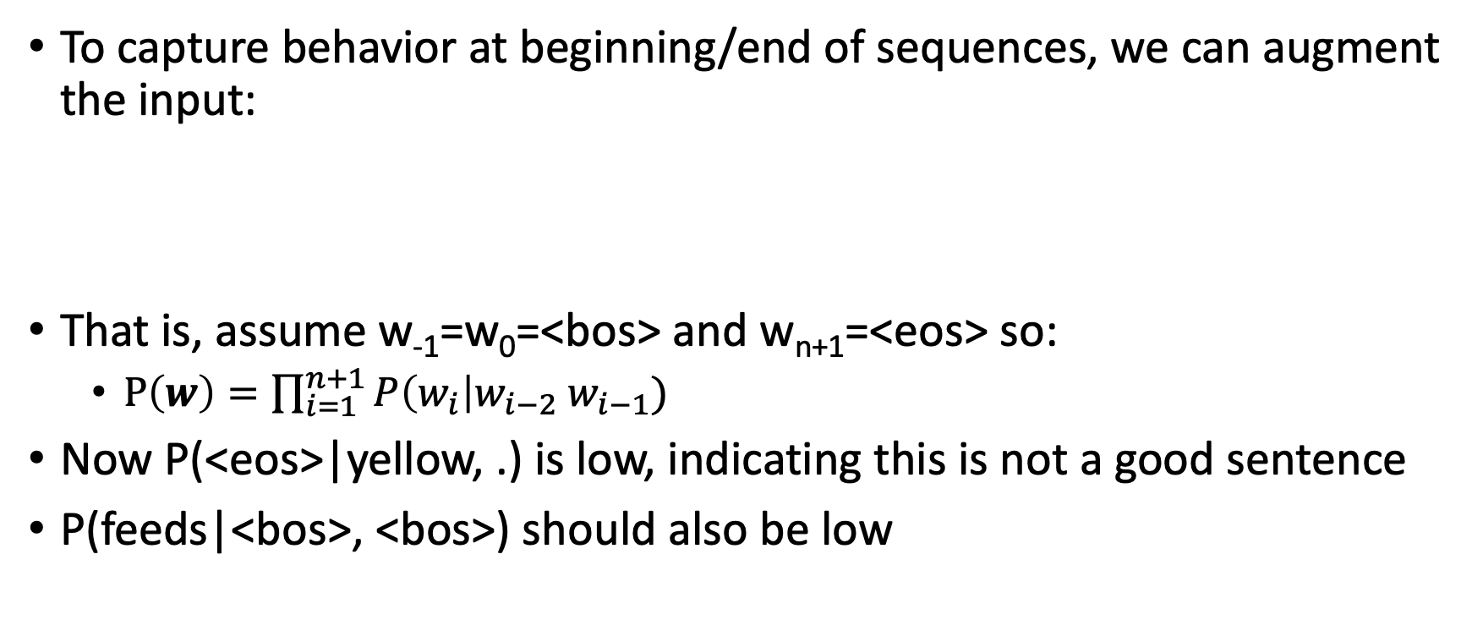
Beginning / end of sequence
To capture behavior at beginning/end of sequences, we can augment the input:
That is, assume w₋₁=w₀=<bos> and w_{n+1}=<eos> so:
$P\left(w\right)=\prod_{i=1}^{n+1}{P\left(w_{i}\right|w_{i−2} w_{i−1})}$
Now P(<eos>|yellow, .) is low, indicating this is not a good sentence
P(feeds|<bos>, <bos>) should also be low
w₋₁ | w₀ | w₁ | w₂ | w₃ | w₄ | w₅ | w₆
<bos> | <bos> | he | saw | the | yellow | . | <eos>
<bos> | <bos> | feeds | the | cats | daily | . | <eos>

Slide 17
Beginning / end of sequence
Alternatively, we could model all sentences as one (very long) sequence, including punctuation
two cats live in sam 's barn . sam feeds the cats daily . yesterday , he saw the yellow cat catch a mouse . [...]
Now, trigram probabilities like P(. | cats daily) and P(, | . yesterday) tell us about behavior at sentence edges
Here, all tokens are lowercased. What are the pros/cons of not doing that?

Slide 18
Practical details (II)
Word probabilities are typically very small.
Multiplying lots of small probabilities quickly gets so tiny we can't represent the numbers accurately.
So in practice, we typically use log probabilities
Since probabilities range from 0 to 1, log probs range from -∞ to 0
Instead of multiplying probabilities, we add log probs
Often, negative log probs are used instead; these are often called "costs"; lower cost = higher prob

Slide 19
Evaluation
Two types of evaluation in NLP
Extrinsic: measure performance on a downstream application
For LM, plug it into a machine translation/ASR/etc system
The most useful evaluation: We usually use LMs to help other tasks
But can be time-consuming
And we still need an evaluation measure for the downstream system
Intrinsic: design a measure that is inherent to the current task
much quicker/easier during development cycle
not always easy to figure out what the right measure is. Ideally, it's one that correlates with extrinsic measures

Slide 20
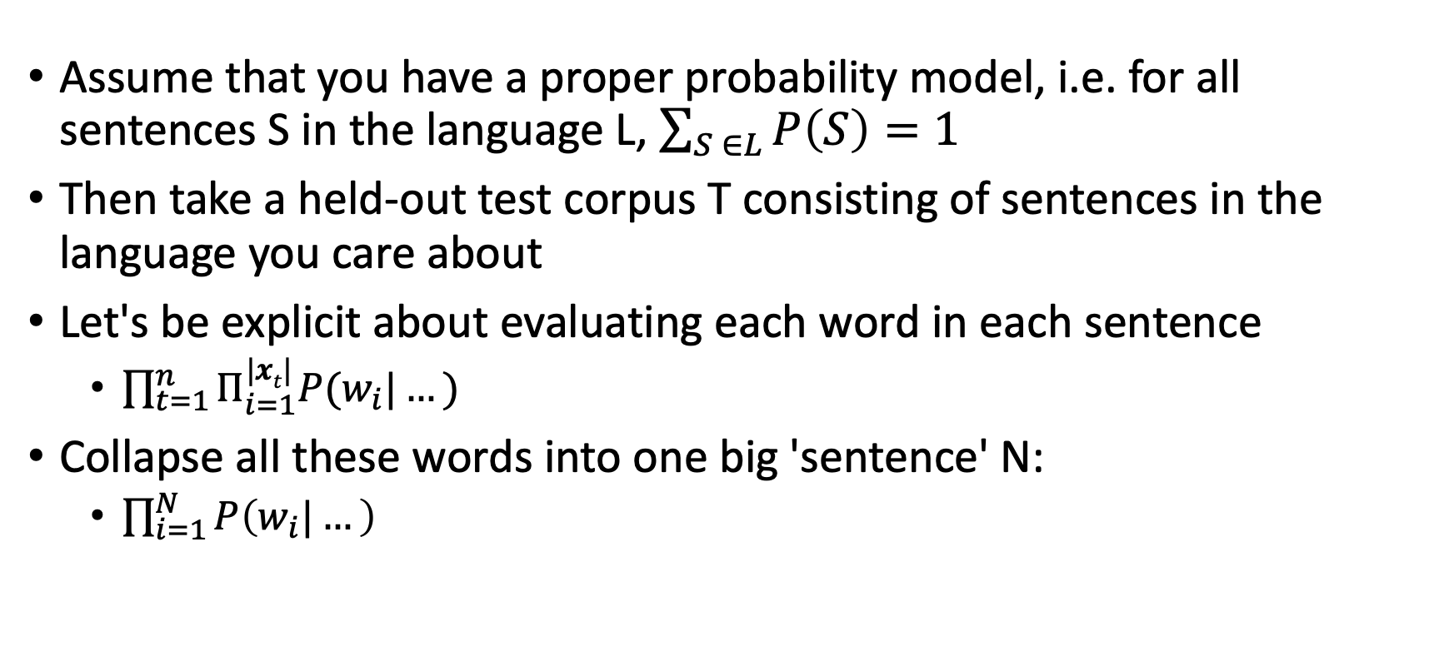
Intrinsically Evaluating a Language Model
Assume that you have a proper probability model, i.e. for all sentences S in the language L, $\sum_{S ∈L}{P\left(S\right)=1}$
Then take a held-out test corpus T consisting of sentences in the language you care about
Let's be explicit about evaluating each word in each sentence
$\prod_{t=1}^{n}{Π_{i=1}^{|xt|}P(w_{i}|…)}$
Collapse all these words into one big 'sentence' N:
$\prod_{i=1}^{N}{P\left(w_{i}|…\right)}$

Slide 21
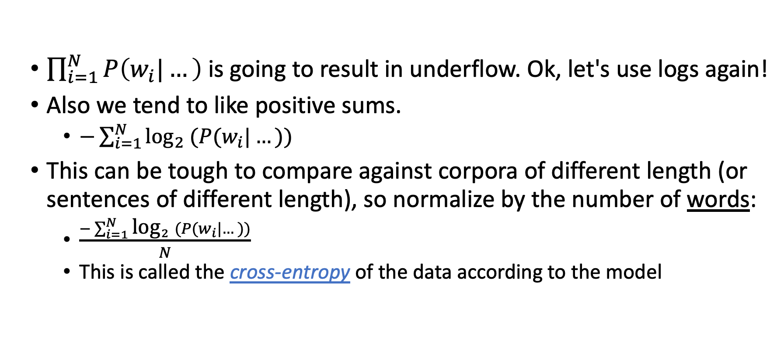
Resolving Some Problems
$\prod_{i=1}^{N}{P\left(w_{i}|…\right)}$ is going to result in underflow. Ok, let's use logs again!
Also we tend to like positive sums.
$−\sum_{i=1}^{N}{{\text{log}}_{2} (P(w_{i}|…))}$
This can be tough to compare against corpora of different length (or sentences of different length), so normalize by the number of words:
$\frac{−\sum_{i=1}^{N}{{\text{log}}_{2} (P(w_{i}|…))}}{N}$
This is called the cross-entropy of the data according to the model

Slide 22
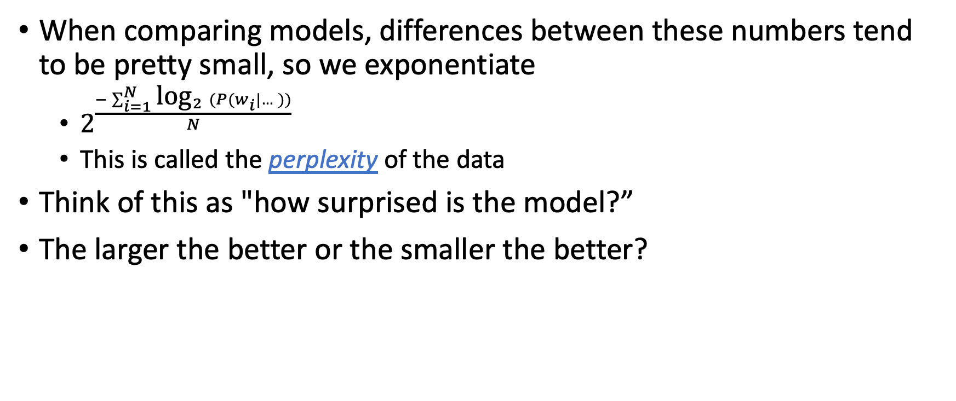
Resolving Some Problems
When comparing models, differences between these numbers tend to be pretty small, so we exponentiate
$2^{\frac{−\sum_{i=1}^{N}{{\text{log}}_{2} (P(w_{i}|…))}}{N}}$
This is called the perplexity of the data
Think of this as "how surprised is the model?”
The larger the better or the smaller the better?

Slide 23
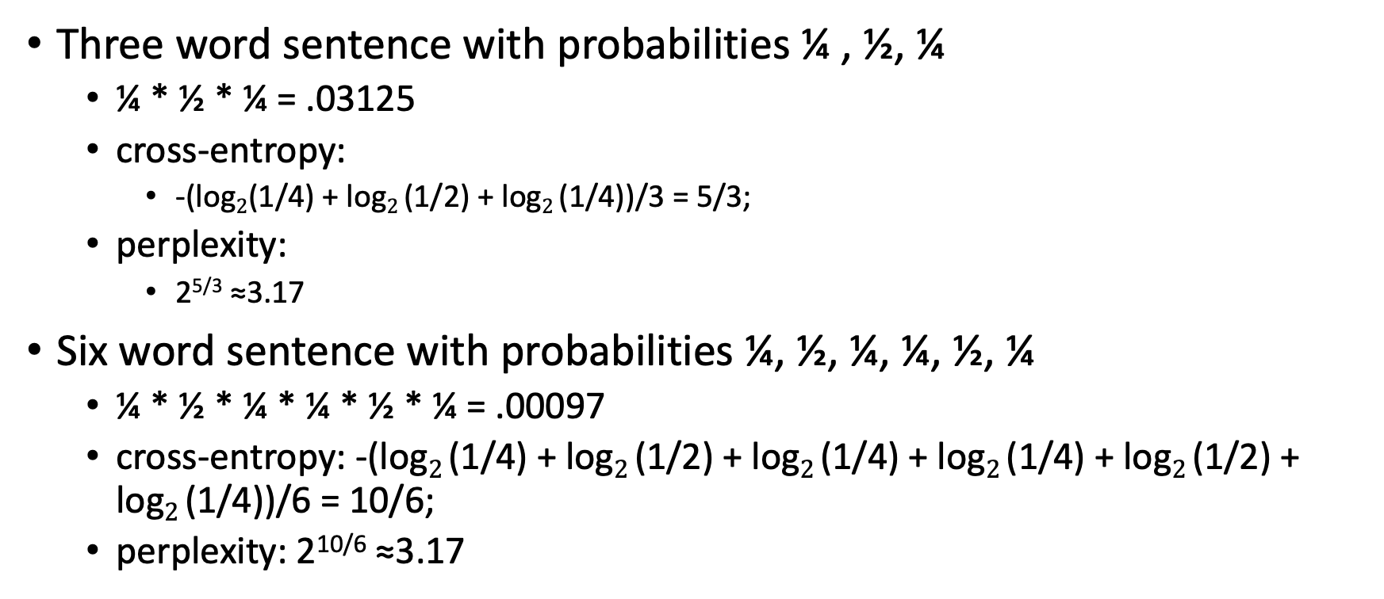
Example
Three word sentence with probabilities ¼ , ½, ¼
¼ * ½ * ¼ = .03125
cross-entropy:
-(log$2$(1/4) + log$2$(1/2) + log$2$(1/4))/3 = 5/3;
perplexity:
2^{5/3} ≈3.17
Six word sentence with probabilities ¼, ½, ¼, ¼, ½, ¼
¼ * ½ * ¼ * ¼ * ½ * ¼ = .00097
cross-entropy: -(log$2$(1/4) + log$2$(1/2) + log$2$(1/4) + log$2$(1/4) + log$2$(1/2) + log$2$(1/4))/6 = 10/6;
perplexity: 2^{10/6} ≈3.17

Slide 24
Intrinsic Evaluation Summary
Lower Perplexity is better
Roughly = number of bits needed to communicate information about a word
The terms 'cross-entropy' and 'perplexity' come out of information theory
In principle you could compare on different test sets
In practice, domains shift. To know which of two LMs is better, train on common training sets, test on common test sets

Slide 25
Word trigrams: A good model of English?
Which sentences are acceptable?
✓
names
all
?
has
s
✓
?
forms
?
was
✗
his house
Example credit: 600.465 – Intro to NLP – J. Eisner
no main verb
same
600.465 - Intro to NLP - J. Eisner
25
has
s
has

Slide 26
Why it does okay …
We never see “the go of” in our training text.
So our dice will never generate “the go of.”
That trigram has probability 0.

Slide 27
Why it does okay … but isn’t perfect.
We never see “the go of” in our training text.
So our dice will never generate “the go of.”
That trigram has probability 0.
But we still got some ungrammatical sentences …
All their 3-grams are “attested” in the training text, but still the sentence isn’t good.
You shouldn’t eat these chickens because these chickens eat arsenic and bone meal …
3-gram model
Training sentences
… eat these chickens eat …

Slide 28
Why it does okay … but isn’t perfect.
We never see “the go of” in our training text.
So our dice will never generate “the go of.”
That trigram has probability 0.
But we still got some ungrammatical sentences …
All their 3-grams are “attested” in the training text, but still the sentence isn’t good.
Could we rule these bad sentences out?
4-grams, 5-grams, … 50-grams?
Would we now generate only grammatical English?

Slide 29
Grammatical English sentences
Possible under trained 50-gram model ?
Training sentences
Possible under trained 3-gram model (can be built from observed 3-grams by rolling dice)
Possible under trained 4-gram model

Slide 30
What happens as you increase the amount of training text?
Training sentences (all of English!)
Now where are the 3-gram, 4-gram, 50-gram boxes?
Is the 50-gram box now perfect?
(Can any n-gram model of language be perfect?)

Slide 31
Are n-gram models enough?
Can we make a list of (say) 3-grams that combine into all the grammatical sentences of English?
Ok, how about only the grammatical sentences?
How about all and only?

Slide 32
Can we avoid the systematic problems with n-gram models?
Remembering things from arbitrarily far back in the sentence
Was the subject singular or plural?
Have we had a verb yet?
Formal language equivalent:
A language that allows strings having the forms a x* b and c x* d (x* means “0 or more x’s”)
Can we check grammaticality using a 50-gram model?
No? Then what can we use instead?

Slide 33
But How To Estimate Sentence Probabilities?
We want to to know the probability of word sequence w = w₁ w₂ ... w_{n} occurring in English
Assume we have some training data: large corpus of general English text
We use this data to estimate the probability of w (even if we never see it in the corpus)
How? ➔ recall the naïve bayes example, make analogies.

Slide 34
Maximum Likelihood Estimation
AKA "Count and divide"
Terminology: Types vs. Tokens
Word type = distinct vocabulary item
A dictionary is a list of types (once each)
Word token = occurrence of that type
A corpus is a list of tokens (each type has many tokens)
We’ll estimate probabilities of the dictionary types by counting the corpus tokens
26 types
300 tokens
a | 100
b | 0
c | 0
d | 200
e | 0
…
z | 0
Total | 300
100 tokens of this type
0 tokens of this type
200 tokens of this type

Slide 35
Maximum Likelihood Estimation
So get a corpus of N sentences
P_{MLE}(w = the cat slept quietly) = C(the cat slept quietly)/N
But consider these sentences:
the long-winded gigantic beast munched contentedly on mushrooms
frugal caught the of about for syntax
Neither is in a corpus (I just made them up), so P_{MLE}=0 for both
But one is meaningful and grammatical and the other isn't!

Slide 36
Sparse Data and MLE
If something doesn't occur, vanilla MLE thinks it can't occur
No matter how much data you get, you won't have enough observations to model all events well with vanilla MLE
We need to make some assumptions so that we can provide a reasonable probability for grammatical sentences, even if we haven't seen them

Slide 37
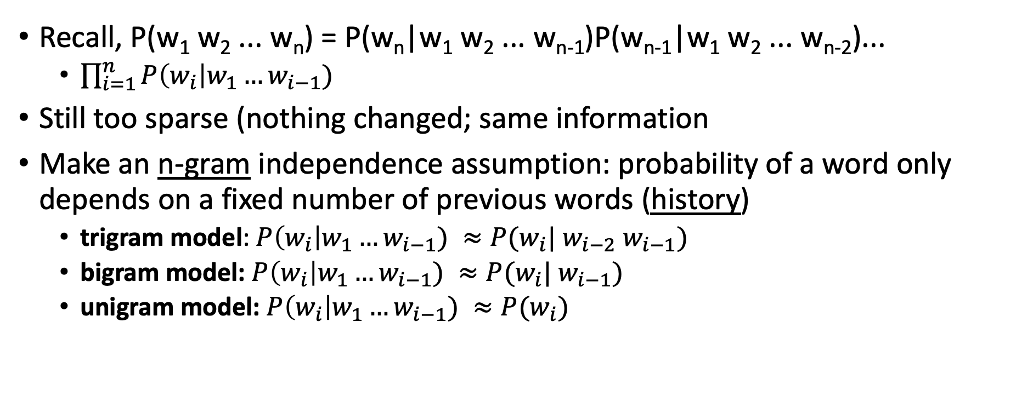
Independence (Markov) Assumption
Recall, P(w₁ w₂ ... w_{n}) = P(w_{n}|w₁ w₂ ... w_{n-1})P(w_{n-1}|w₁ w₂ ... w_{n-2})...
$\prod_{i=1}^{n}{P\left(w_{i}\right|w_{1}…w_{i−1})}$
Still too sparse (nothing changed; same information
Make an n-gram independence assumption: probability of a word only depends on a fixed number of previous words (history)
trigram model: $P\left(w_{i}\right|w_{1}…w_{i−1}) ≈P(w_{i}| w_{i−2} w_{i−1})$
bigram model: $P\left(w_{i}\right|w_{1}…w_{i−1}) ≈P(w_{i}| w_{i−1})$
unigram model: $P\left(w_{i}\right|w_{1}…w_{i−1}) ≈P(w_{i})$

Slide 38

Estimating Trigram Conditional Probabilities
P_{MLE}(mast | before the) = Count(before the mast)/Count(before the)
In general, for any trigram, we have
$P_{MLE}\left(w_{i}\right|w_{i−2} w_{i−1})= \frac{\text{Count}(w_{i−2}{ w}_{i−1} w_{i})}{\text{Count}(w_{i−2} w_{i−1})}$

Slide 39
Example from Moby Dick corpus
C(before, the) = 25; C(before, the, mast) = 4
C(before, the, mast) / C(before, the) = 0.16
mast is the most common word to come after "before the" (wind is second most common)
P_{MLE}(mast) = 56/110927 = .0005 and P_{MLE}(mast|the) = .003
Seeing "before the" vastly increases the probability of seeing "mast" next

Slide 40
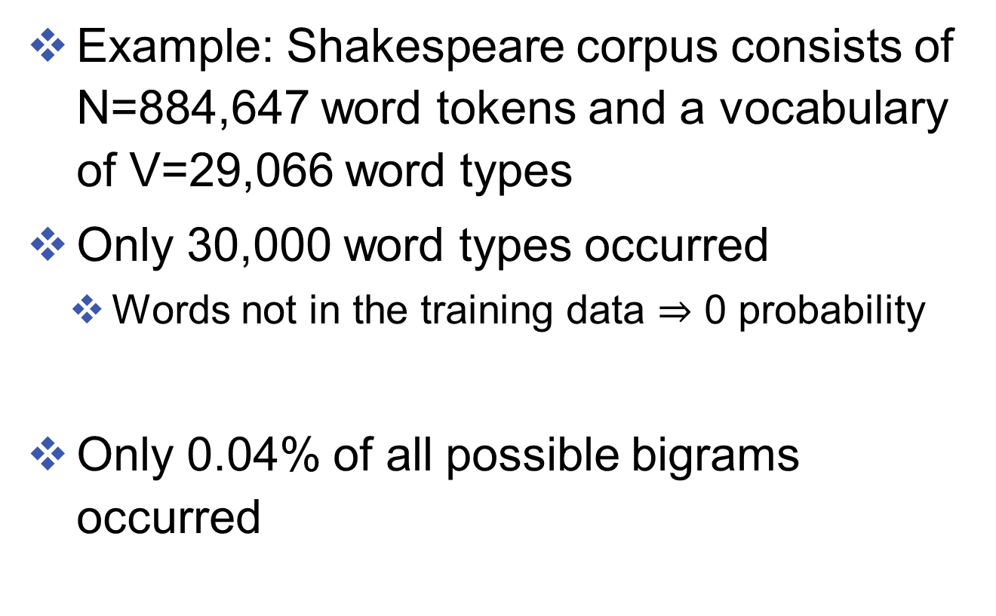
How about unseen words/phrases
Example: Shakespeare corpus consists of N=884,647 word tokens and a vocabulary of V=29,066 word types
Only 30,000 word types occurred
Words not in the training data $⇒$ 0 probability
Only 0.04% of all possible bigrams occurred

Slide 41
Next Time...
Dealing with unseen n-grams -- smoothing
Key idea: reserve some probability mass to events that don’t occur in the training data
How much probability mass should we reserve?

